Slide 1
OBEaaS Outcome Based Education as a Service
Group Members:
Aqib mukhtar se-056
Abdul rehman se-050
Muhammad uzair se-052
Internal supervisor:
Miss asma khan
Industrial advisor:
Dr. Farrukh arif
Software engineering department
Neduet, karachi

Slide 2
Contents
Introduction
What had to be achieved
What problems we faced during this time
How we overcame these problems
What we have achieved
N-tier Architecture
Future Plans

Slide 3
Introduction
OBEaaS provides integrable microservices that aims to digitally transform the OBE system.
It aims to provide a digitalized approach for the process of assigning marks and maintaining the academic records of students on the basis of OBE.
The motivation behind this project is to reduce the efforts the teachers have to make in handling the student’s records manually.
It also aims to provide the students a platform where they can see their progress report in each semester.

Slide 4
What we planned to do till the first evaluation
According to the gantt chart we had to prepare following things for the first evaluation:
Software Requirement Specification (SRS)
Architectural Diagrams
Entity Relationship Diagram (ERD)
Application Structure
Wireframes

Slide 5
What problems we faced during this time
Due to the ongoing pandemic, it became difficult to communicate with our industrial supervisor.
Due to lockdown, it became difficult for us to arrange meetings with our industrial supervisor to gather requirements
Lack of communication made it difficult for us to understand the requirements.
All this resulted in consuming more time in requirement gathering than what we planned.

Slide 6
How we overcame these problems!
We extracted the requirements from the meetings that we carried out with our industrial supervisor before the lockdown.
We used Goal Oriented Requirement Engineering (GORE) to gather well-defined requirements.
In order to compensate the extra time that we spent on requirement gathering phase, we gave extra time to our project, working restlessly to meet the defined milestones in time.

Slide 7
What we have achieved
We have achieved all the milestones that we defined till the end of December in the gantt chart:
Software Requirement Specification (SRS)
Architectural Diagrams
Entity Relationship Diagram (ERD)
Application Structure
Wireframes
Usecase Diagram
Context Diagram
Component Diagram

Slide 8
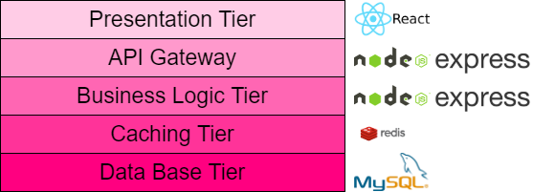
N-Tier Architecture
The five layers of our architecture are as follows:
Application Tier
API Gateway
Business Logic Tier
Caching Tier
Database Tier

Slide 9
Future Plans
According to the Gantt chart we had to prepare following for the next evaluation:
Database Procedures
Representational State Transfer Application Programming Interfaces (REST APIs ).

Slide 10
Thank You

